Slide 1
Early Detection of Wheat Diseases
CSE7302- University Project
Review-1
Batch Number:ISE-4
Under the Supervision of:
Dr.Yamanappa
Assistant Professor
School of Computer Science and Engineering
Presidency University
Roll Number | Student Name
20221ISE0109 | Pallavi J
20221ISE0117 | Ganavi HR
20221ISE0135 | Chandrakala KT
Name of the Program: Btech Information Science and Engineering
Name of the HoD: Dr. Gopal Shyam
Name of the Program Project Coordinator: Ms. Suma NG
Name of the School Project Coordinators: Dr. Sampath A K , Dr. Geetha A

Slide 2
Problem Statement Number: SIH25268
Organization: Ministry of Agriculture & Farmers Welfare- Government of India
Category :Software
Problem Description:
Wheat is one of the most important staple crops in India, and its productivity is significantly
affected by diseases such as leaf rust, brown rust, and leaf blight. Early identification of these
diseases is challenging for farmers due to lack of expert knowledge, delayed field inspections, and
limited access to agricultural advisory services. Late detection often leads to severe crop damage,
reduced yield, and economic loss for farmers. There is a need for an automated and reliable system
to assist farmers in the early detection of wheat diseases.

Slide 3
Objective:
To develop an automated system for early detection of wheat diseases
To assist farmers in identifying crop health conditions using image analysis
To reduce crop loss through timely disease detection
To provide advisory support for preventive actions
To enable data-driven monitoring of disease patterns

Slide 4
Background and Related Work:
Traditional methods of disease identification rely on manual inspection by experts, which is time-consuming and not always accessible to small-scale farmers. Recent research has explored the use of image processing and machine learning techniques for crop disease detection. However, many existing solutions lack usability, early-stage detection capability, and analytics support. The proposed system utilizes deep learning-based image analysis to provide a practical and scalable solution for early detection of wheat diseases.

Slide 5
Three-Layer System Architecture
Presentation Layer
Image input interface (local system)
Visualization of prediction results
Graphical analysis outputs
Application Layer
Deep learning model for disease classification
Image preprocessing and feature extraction
Prediction and advisory logic
Data Layer
Wheat leaf image dataset
Trained model storage
Prediction and analysis results

Slide 6
Technology Stack Components
Programming Language: Python
Development Environment: Google Colab / VS Code
Deep Learning Framework: TensorFlow / Keras
Libraries: NumPy, Pandas, Matplotlib
Dataset: PlantVillage Wheat Disease Dataset

Slide 7
System Workflow
Wheat leaf image is provided as input
Image preprocessing (resizing and normalization)
Feature extraction using CNN
Disease classification using trained model
Display of detected disease and confidence score
Advisory recommendations for farmers
Visualization of disease trends and analysis

Slide 8
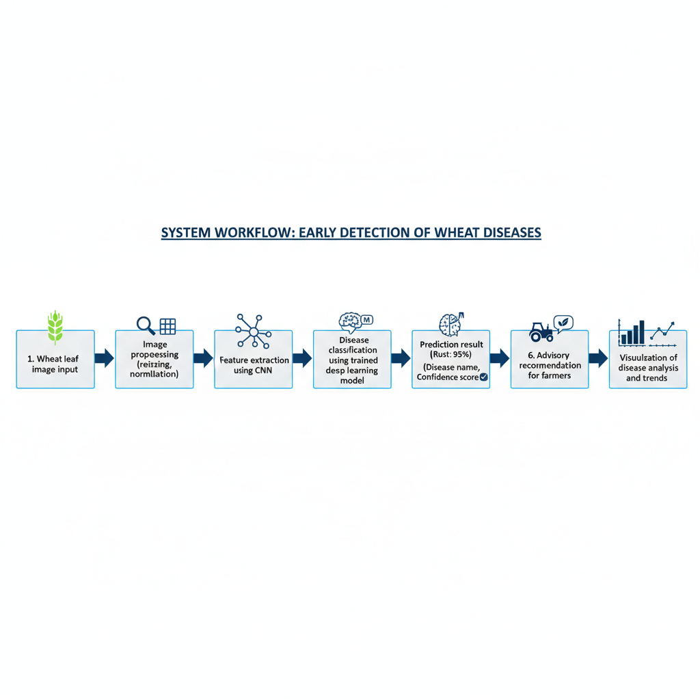
System Workflow

Slide 9
Github Link
GitHub Link:
https://github.com/Pallavijagadish/Early-wheat-disease-detection

Slide 10
Timeline of the project
Review 1
Problem identification
Literature survey
Dataset collection and analysis
Review 2
Model architecture design
Image preprocessing implementation
Initial model training
Review 3
Model optimization and testing
Accuracy and performance evaluation
Visualization and analytics development
Review 4
Final testing and validation
Documentation and report preparation
Project demonstration

Slide 11
Expected Outcomes
Early identification of wheat diseases
Reduction in crop damage and yield loss
Improved decision-making for farmers
Efficient and low-cost disease detection solution
Support for sustainable agriculture practices

Slide 12
References :
Mohanty, S. P., Hughes, D. P., & Salathé, M., “Using Deep Learning for Image-Based Plant Disease Detection,” Frontiers in Plant Science, 2016.
PlantVillage Dataset – Open Source Crop Disease Dataset
Research articles on AI-based agricultural disease detection

Slide 13


